Slide 1


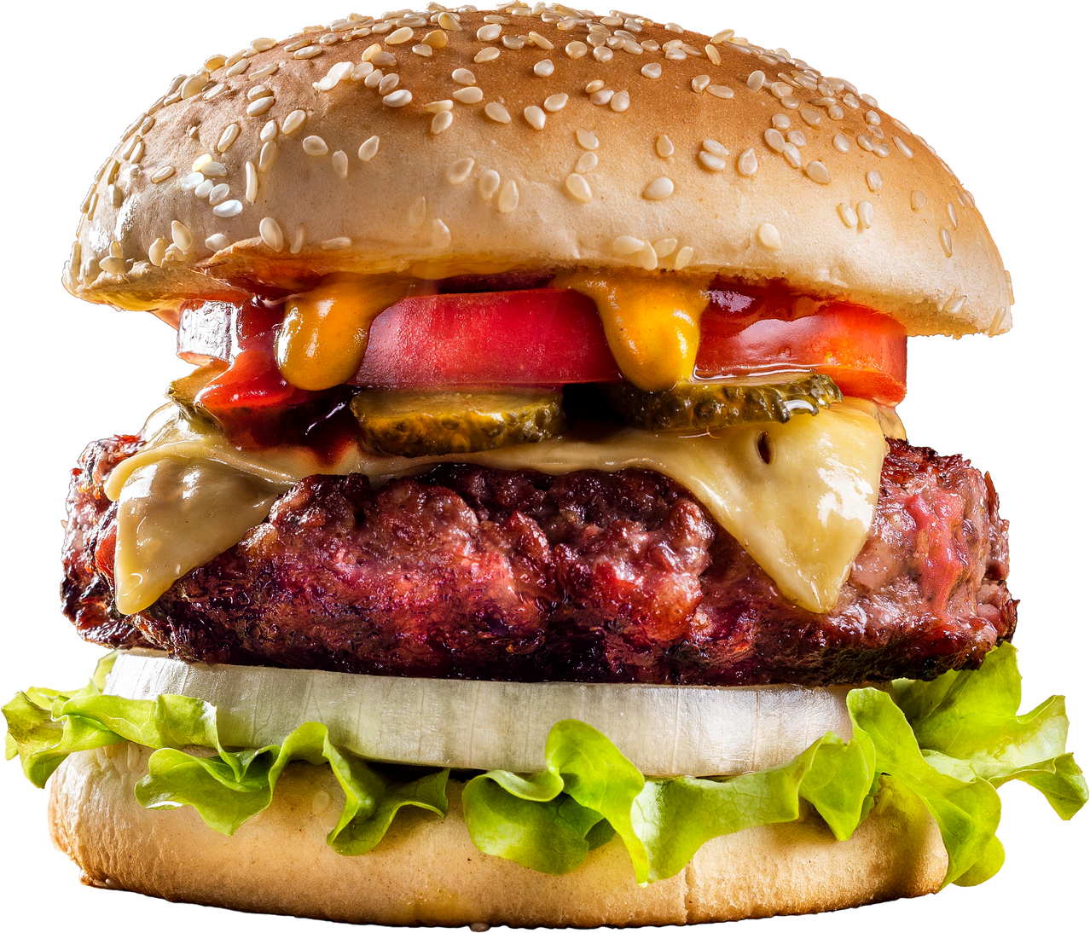



BORCELLE
MCDONALD'S
MCDONALD'S BURGERS
I'm Lovin' It.

Slide 2




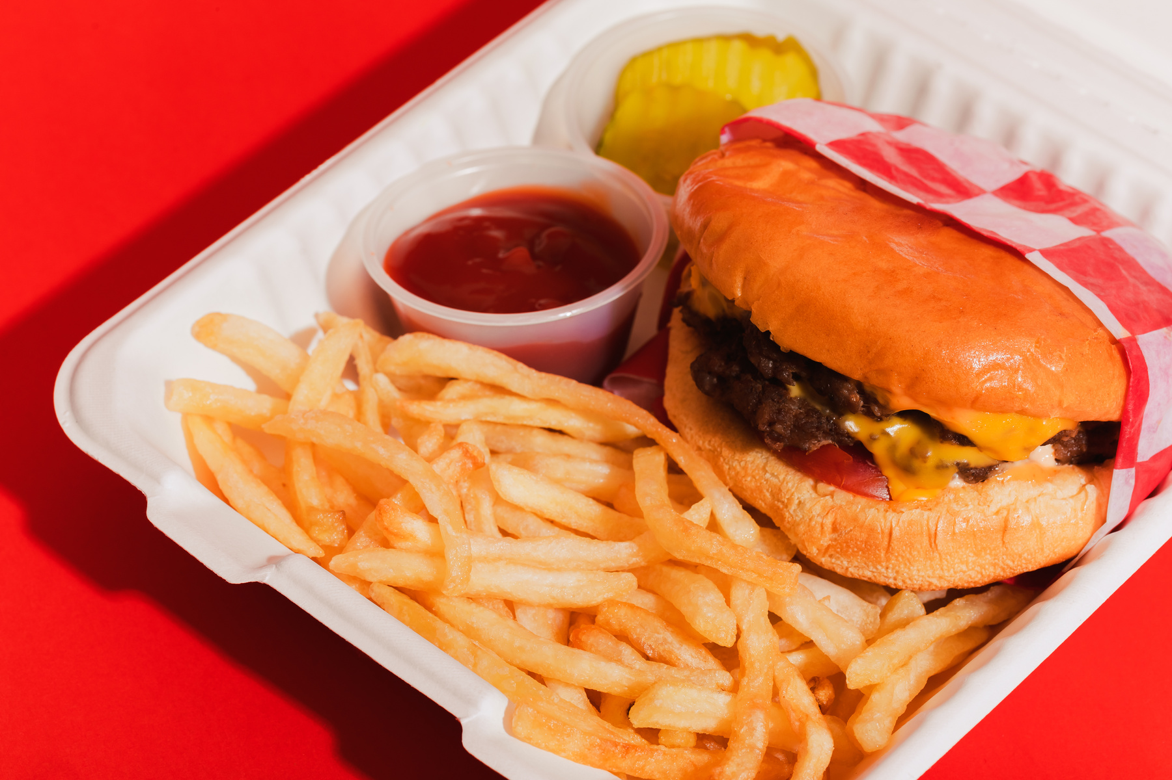


BORCELLE
MCDONALD'S
ABOUT US
At McDonald’s, the hamburger is more than just a menu item — it’s a symbol of our commitment to quality, simplicity, and great taste.
Our mission is to deliver a consistently delicious hamburger that brings joy to every bite. At McDonald’s, we are committed to using 100% pure beef, simple ingredients, and time-tested preparation to create a classic burger experience that’s loved around the world.

Slide 3
BORCELLE
MCDONALD'S
MCDONALD'S SALES
1. What is the total sales revenue for each category of menu items?
2. How many orders are placed each day?
3. Which menu item is the most frequently ordered?
4. What is the total revenue generated by menu items?
5. How does the revenue of each category compare over months?

Slide 4
BORCELLE
MCDONALD'S
MCDONALD'S SALES
6. What is the average number of items per order?
7. How do order volumes vary by time of day?
8. How do sales trends differ across weekdays and weekends?
9. How does the sales performance vary by category over different months?
10. Compare the sales of top 5 menu items.

Slide 5
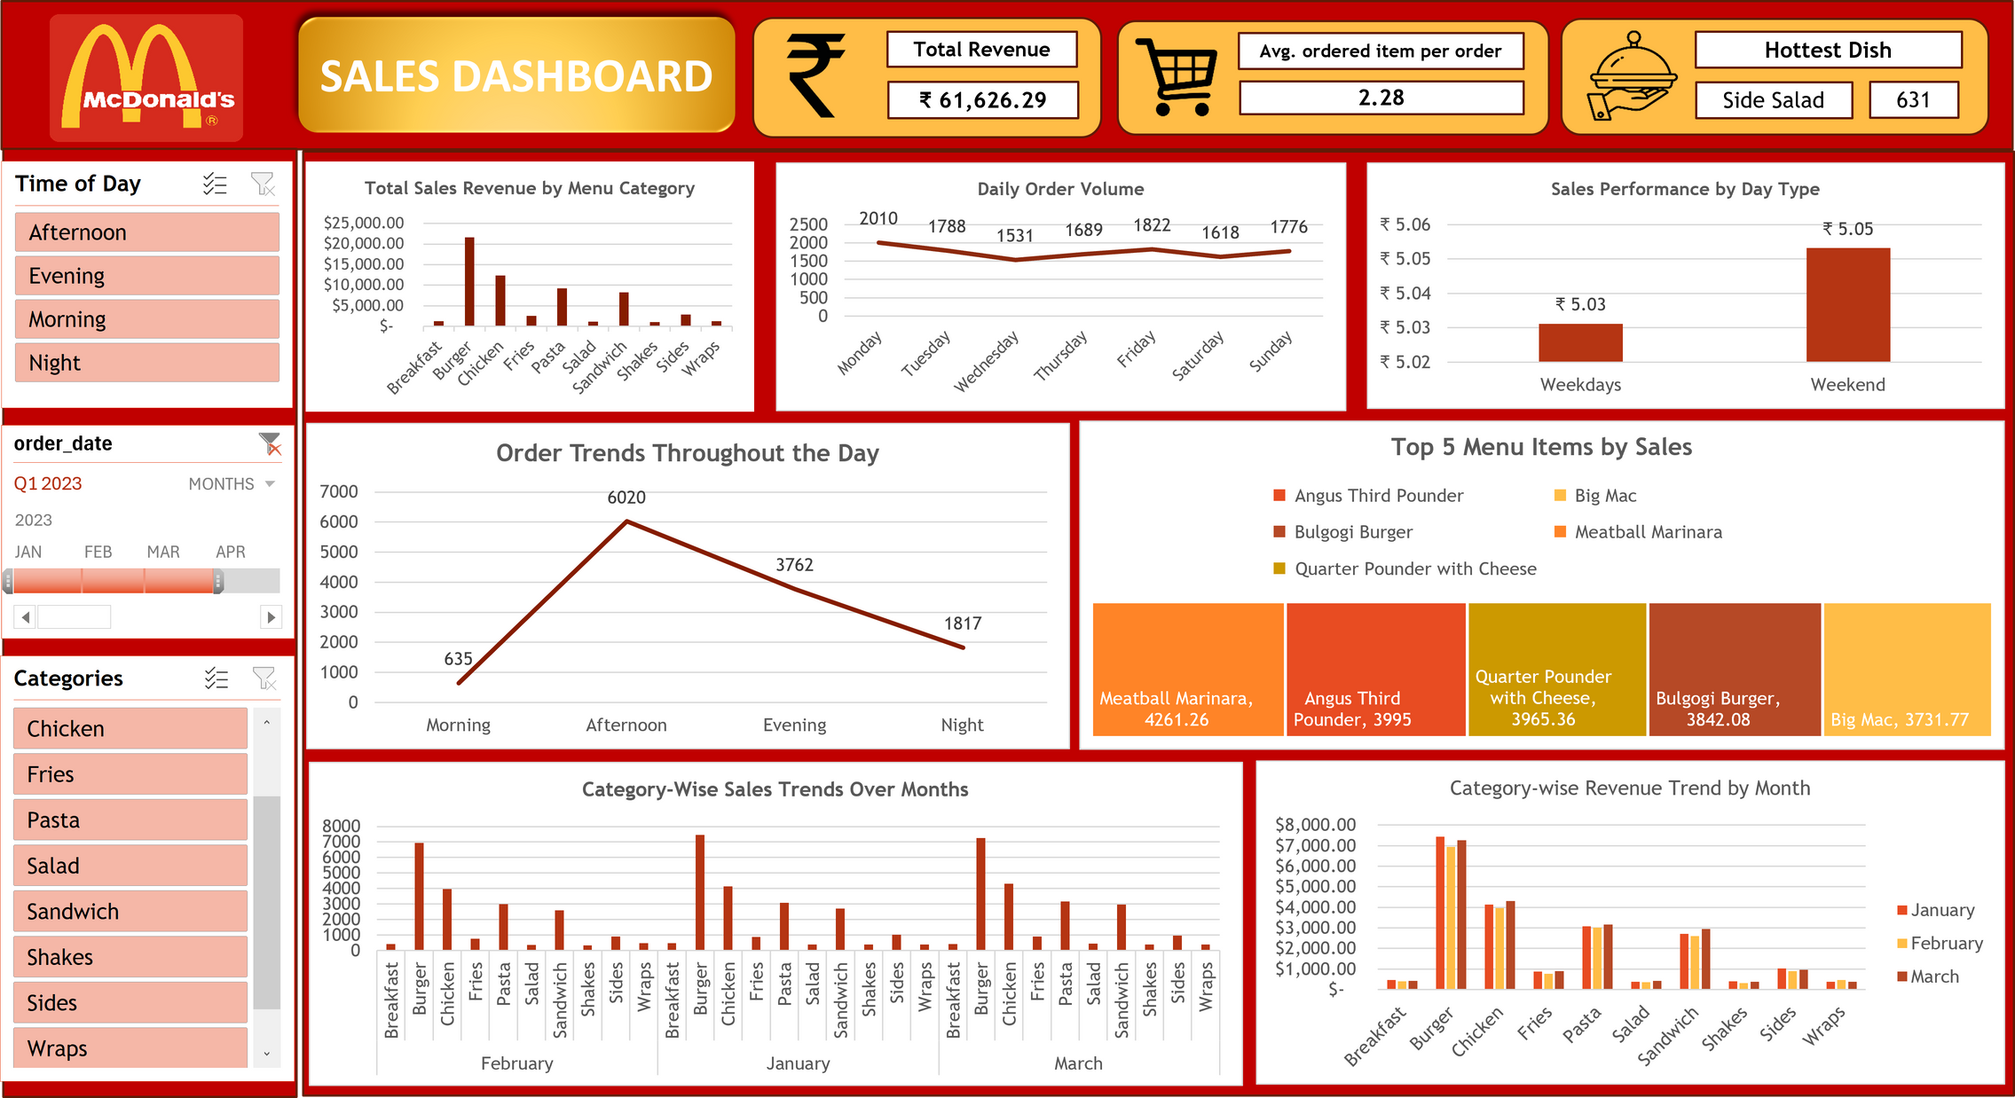
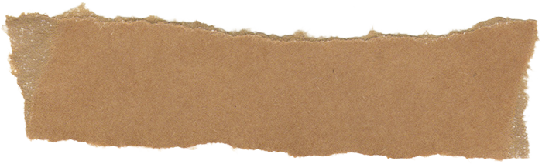
BORCELLE
MCDONALD'S
EXCEL DASHBOARD

Slide 6
BORCELLE
MCDONALD'S
PROBLEM 1 INSIGHTS
Burger, Chicken, and Pasta consistently generate higher sales revenue compared to other items, ranking first, second, and third respectively. Given that Chicken and Pasta are priced higher than Burgers, they offer greater profit potential despite lower sales volumes. Therefore, it would be strategic to focus more on promoting Chicken and Pasta.
1

Slide 7
BORCELLE
MCDONALD'S
PROBLEM 2 INSIGHTS
The data indicates that order volumes are higher on weekdays compared to weekends. Monday records the highest number of orders at 2,010, followed by Friday with 1,822 orders, and Tuesday with 1,788 orders, ranking second and third respectively.
2

Slide 8
BORCELLE
MCDONALD'S
PROBLEM 3 & 4 INSIGHTS
The most frequently ordered item is the Side Salad, with a total of 631 orders.
3
The total revenue generated from sales amounts to ₹61,626.29.
4

Slide 9
BORCELLE
MCDONALD'S
PROBLEM 5 INSIGHTS
Burger remains the top revenue-generating category across all three months (Jan, Feb, Mar), maintaining consistent performance.
Chicken, Pasta, and Sandwich also show stable revenue, ranking next after Burger.
Other categories like Breakfast, Salad, Shakes, Sides, and Wraps generate significantly lower revenue, indicating limited contribution to overall sales.
Revenue trends are fairly consistent month-over-month, suggesting stable customer preferences.
5

Slide 10
BORCELLE
MCDONALD'S
PROBLEM 6 INSIGHTS
The average number of items per order is currently 2.28. This could potentially increase to 3 if targeted discounts are offered on combinations such as Chicken and Salad.
6

Slide 11
BORCELLE
MCDONALD'S
PROBLEM 7 INSIGHTS
The highest number of orders occurs in the afternoon, totaling 6,020, followed by the evening with 3,762 orders, and the night with the lowest volume. This indicates that a majority of customers visit McDonald's primarily for lunch.
7

Slide 12
BORCELLE
MCDONALD'S
PROBLEM 8 INSIGHTS
The chart titled "Weekday vs. Weekend Sales Trends" illustrates the average menu price (used as a proxy for sales) based on day type. The data reveals that:
Weekday sales are higher, averaging slightly above $5.04.
Weekend sales are lower, averaging just above $5.00.
8

Slide 13
BORCELLE
MCDONALD'S
PROBLEM 9 INSIGHTS
Burger consistently leads in quantity sold across all three months (Jan, Feb, Mar), confirming strong and steady demand.
Chicken, Pasta, and Sandwich also show stable sales performance, positioning them as reliable mid-tier items.
Lower-performing categories such as Shakes, Sides, Salad, and Wraps show minimal variation, indicating weak or niche demand.
Overall category trends remain consistent, suggesting predictable customer preferences with minimal seasonal impact.
9

Slide 14
BORCELLE
MCDONALD'S
PROBLEM 10 INSIGHTS
Meatball Marinara is the highest revenue-generating item, followed closely by the Angus Third Pounder and Quarter Pounder with Cheese.
Big Mac and Bulgogi Burger also rank among the top five, contributing significantly to overall revenue.
These items represent strong performers and should be prioritized in promotions and meal bundles to maximize profitability.
10

Slide 15
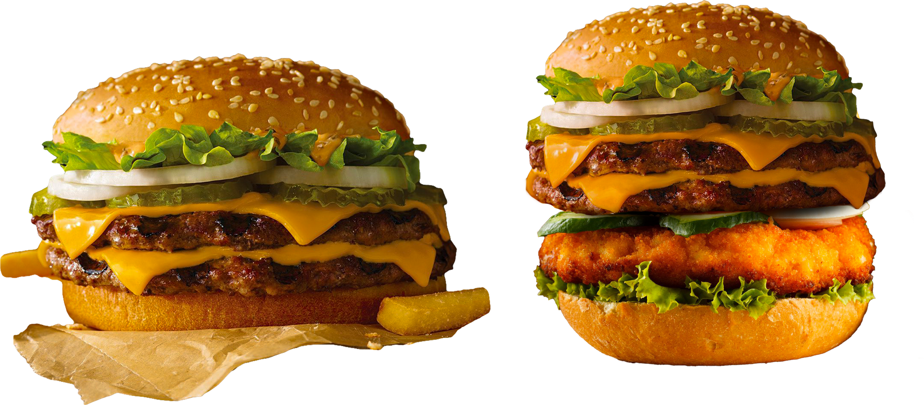
BORCELLE
MCDONALD'S
CONTACT US
Address
110 N. Carpenter Street
Chicago, Illinois 60607
United States
Phone Number
+91 9467671237
Email Adress
farookmohammad27@gmail.com

